Slide 1

Date: 28/10/2024
Group Name: A147 Name of Student Presenting: Haroon

Slide 2
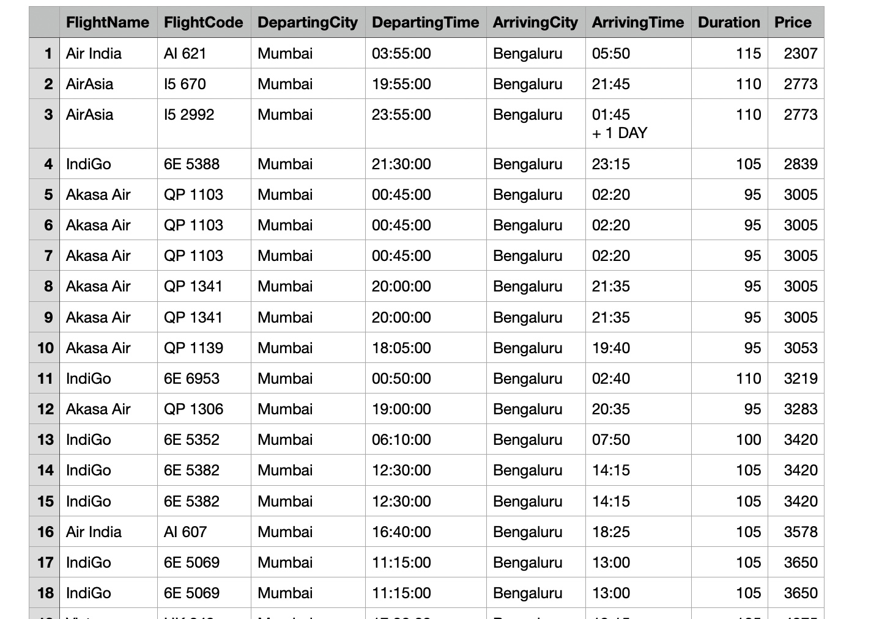
Dataset – Airline ticket price in India DS-115
Our dataset flight_data.csv has 404 rows

Slide 3
This dataset is interesting to us because it provides a clear view into India’s competitive aviation market, offering insights into pricing strategies, peak travel timings, and traveler preferences on high-demand routes.. Our Independent variable is: Duration This Independent variable datatype is : Continuous Our Dependent variable is: Price This Dependent variable datatype is : Continuous
Dataset ID: DS115

Slide 4
Is there a correlation between price & duration for domestic flights in India?
Our Research Question is:

Slide 5
1. Null hypothesis (H_{o}): There is no correlation between price and duration for domestic flights in India. 2. Alternative hypothesis (H₁): There is a correlation between price and duration for domestic flights in India.

Slide 6
Visualisation And DataSheet

